Slide 1
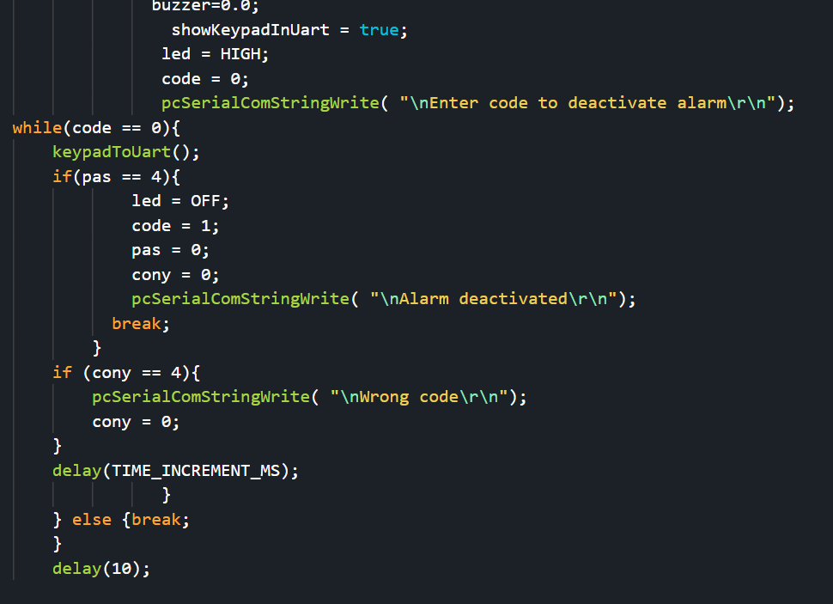
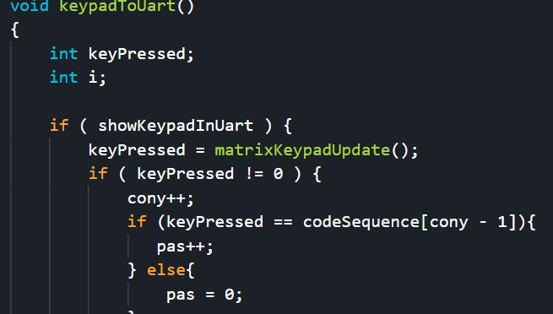
Embedded Systems Lab Worksheet
Student Name: Zeyad Karima
ID Number: 23077460
Lab. Number: lab 5
Date: 02/052025
Lab Title:
Outline of Approach (Description of Tasks)
Itemize all key steps you took to build the required embedded system in a clear, logical and organised format.
1.Create a passcode to turn off alarm
2.Show when you have to type the alarm
3.Show the time of past 5 alarms
4.Show the alarm times if star is placed
.
.
.
Reflection (Not more than 200 words)
Added the use of a keypad to the previous lab of detecting sensors and sending a warning when its above a limit while also creating a passcode using the keypad to turn off the alarm.
It was fun to play with a keypad and learn how different inputs work such as a keypad compared to a button.
It was good to learn how the keypad worked after a few tries as it took a few hours to find out some problems that occurred when trying to use the keypad.
In this situation the keypad was very good to learn about and understand how it works with the board to input the numbers and letters.
Ive learned how to connect new devices such as the keypad and how to code and manipulate the input data.
My plan for the next lab is to simplify my code as it has become long and complicated.
Github with video evidence: https://github.com/ZeyadK05/Lab-5
Results for Part:1
(Input only lab results, Git-hub code link, Flow chart, calculations or picture evidence of simulation/circuits/figures obtained).
All figures should be captioned with relevant title and a brief description to present the essential details).
I used lab 4 for simplicity,
In my alarm code I added a while
Loop which will keep going and read
Keypad inputs. In the keytouart
Function I check to see if my code
Is equal to the keypressed, if it is the variable pas is increased and if it passes 4 then the alarm is off, instead of using a hashtag I decided to read the inputs and if 4 inputs are entered a new line is made.
References
Reference guide here

Slide 2
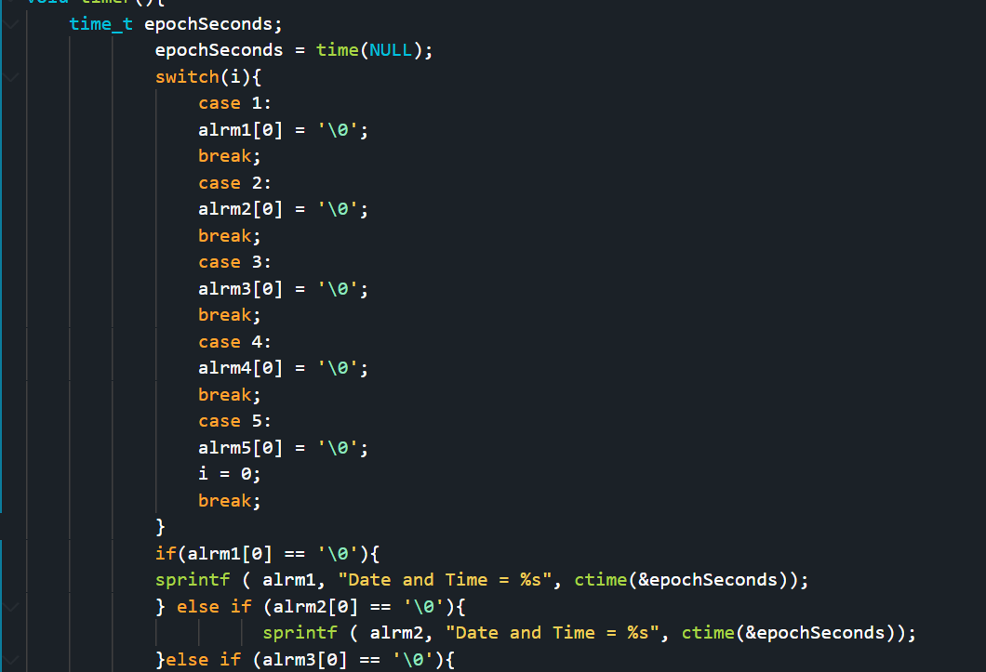
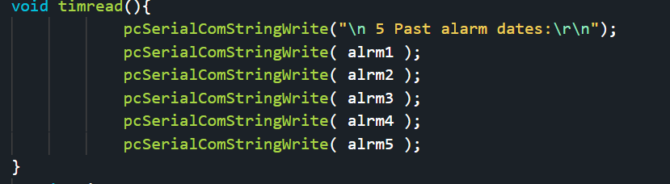
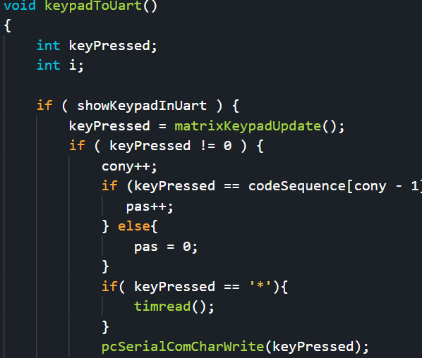
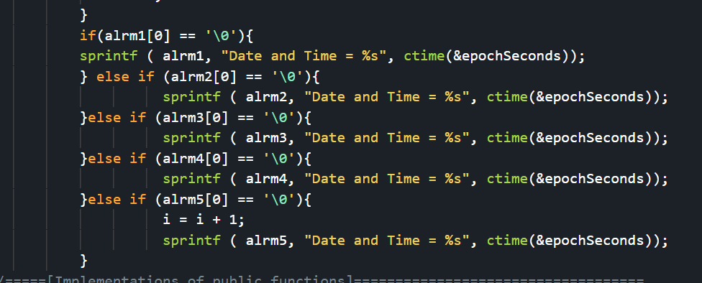
Results for Part:2
(Input only lab results, Git-hub code link, Flow chart, calculations or picture evidence of simulation/circuits/figures obtained).
All figures should be captioned with relevant title and a brief description to present the essential details).
I just added a serial print before the alarm while loop to indicate that the code must be entered.
Results for Part:3
(Input only lab results, Git-hub code link, Flow chart, calculations or picture evidence of simulation/circuits/figures obtained).
All figures should be captioned with relevant title and a brief description to present the essential details).
Simple function before the while loop to input the alarm and if 5 is already inputted it will delete the earliest one.
Results for Part:4
(Input only lab results, Git-hub code link, Flow chart, calculations or picture evidence of simulation/circuits/figures obtained).
All figures should be captioned with relevant title and a brief description to present the essential details).
Function to output the arrays if star is pressed.

